Slide 1
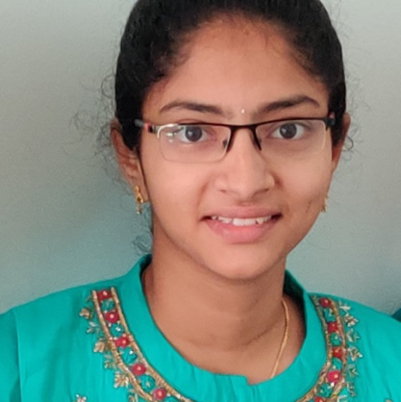



Bonthu Navya Sri
Analyst/Software Engineer
Bachelor of Engineering
Computer Science : 2017 - 2021
Skills
Java 8 /J2EE | Java Basics, OOPS, Generics, Collections, Arrays, Loops, Lambda Exp, Stream API Junit, Mockito
Spring core | IOC & Dependency Injection, Autowire
Spring REST | REST controllers, Implementation of GET, POST, PUT & DELETE, Bean Validation & Annotations
Spring Data JPA | Implement DAO layer using spring Data repositories, Transaction Management
Spring Boot Microservices | Spring Boot Starters, annotations, Messaging Service, Swagger API documents
Spring Cloud | Eureka, Netflix Hystrix, Netflix Zuul & Config Server
Angular | Components, Services, Modules, Routing, Forms & Validation, Testing using Jasmine & Karma
Database | MongoDB
UI Tech | HTML 5 & CSS 3,JavaScript, ES6 & TypeScript
Tools | Git, Postman, Maven, IDE
Add On skills | Communications, Team management. Peer learning
Bangalore
Navya-sri.bonthu@capgemini.com
+919652606488
A4
Full Stack Developer
Hands on experience in creating microservices with Springboot, Spring Security, Spring Cloud API Gateway, Eureka server
Hands on experience in creating frontend using angular with components,routing ,services
Hands on Experience in Mongodb connection with Application using spring boot and angular
Experience on implementing Swagger , Testing, Mockito
Experienced in resolving the errors in SpringBoot and Postman,Angular
Hands on Api REST controllers like GET,PUT,POST and Delete .
Hands on using Annotations in Spring Framework
Flight Booking System Application
Completed end to end case study of Flight Booking System Application along with JWT authentication, Swagger and payment testing using Stripe and Angular used for user interface.
For backend created four microservices which one of them is connected with Eureka server,Api gateway,Swagger,Testing and also implemented Mongodb collection
Connected Backend and Frontend with CrossOrigin.
For frontend created components and, routing and css using bootstrap and materials and forms
Check out my work on GitHub & Video Profile

